Slide 1
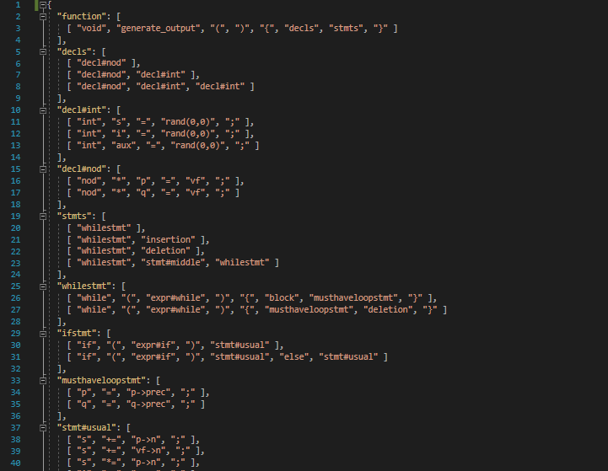
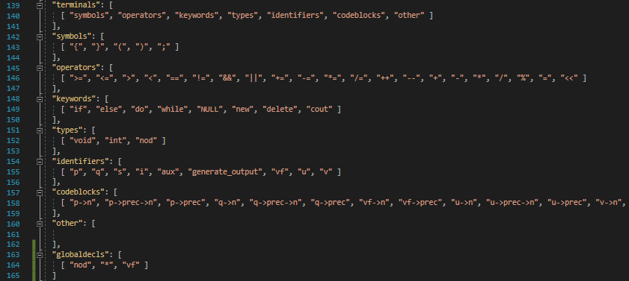

Slide 2

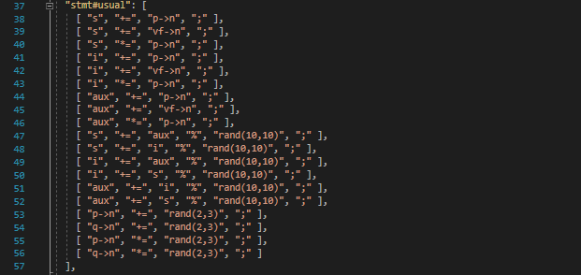

Slide 3


Slide 4
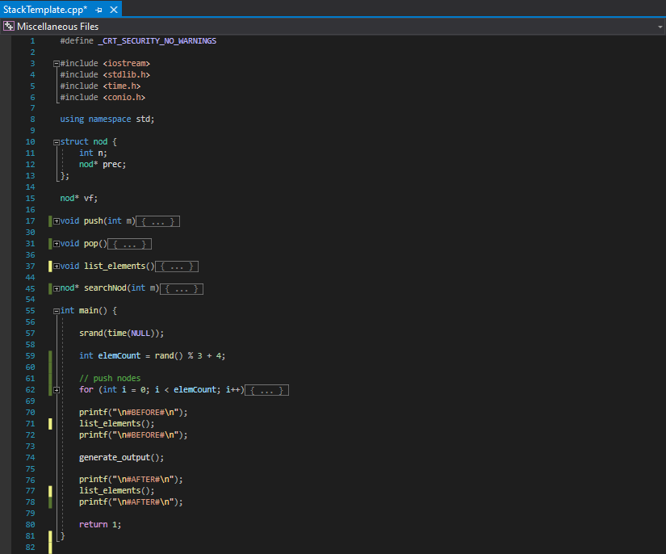

grad de unicitate = $\frac{\text{num}\text{ă}\text{rul} \text{de} \text{linii} \text{de} \text{cod} \text{distincte}}{\text{num}\text{ă}\text{rul} \text{total} \text{de} \text{linii} \text{de} \text{cod}}$

Slide 5








